Slide 1
Front End Development using React
Srinivasulu Yepuru

Slide 2
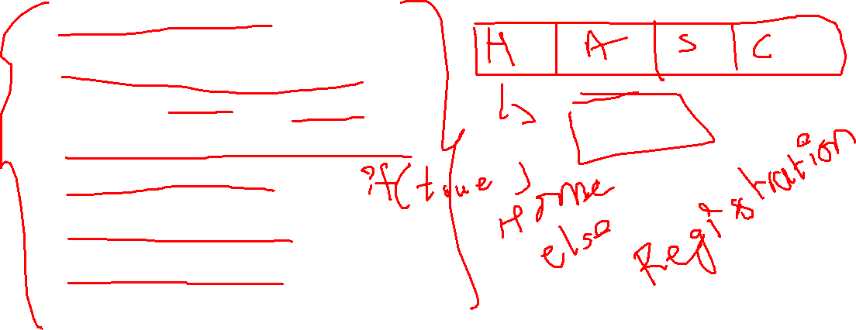
Objective
At the end of this Session the participants will be able to understand
Basics of React JS ?
What is and Why React JS ?
What is a Component & its types ?
How will components talk/communicate ?
Conditional Rendering ?
How to Handle Events ?
Routing in React JS ?
Quiz & Assessment on Mettl ?

Slide 3
Targetted audience
This Session on React JS was planned for the participants of below levels:
Beginner

Slide 4

Tools you need
Install Node.js and npm globally on your machine.
Visual Studio Code — as an IDE (you can use any).

Slide 5

Prerequisites
HTML,CSS and Java Script
ES6 Syntax, Arrow functions,const etc..

Slide 6
What is and Why React ?

Slide 7
What is a react js ?
REACT JS is an open-source front-end JavaScript library for building user interfaces.
ReactJS is maintained by Facebook and a community of individual developers and companies.

Slide 8
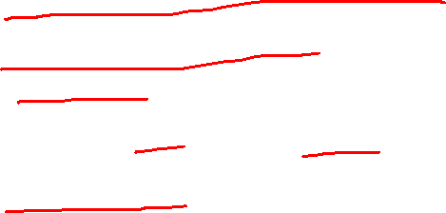
What is React ?
Open-source library for building user interfaces
Not a framework-unlike Angular
Focus on UI
React is the view layer of an MVC application (Model View Controller)
Rich ecosystem.

Slide 9
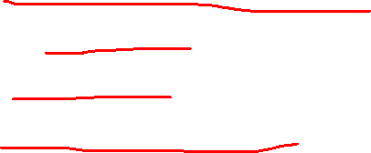
Why learn React ?
Created and maintained by Facebook.
More thank 100k + stars on GitHub.
Huge community.
High Demand skillset.

Slide 10
Why learn React ?
Component based Architecture.

Slide 11
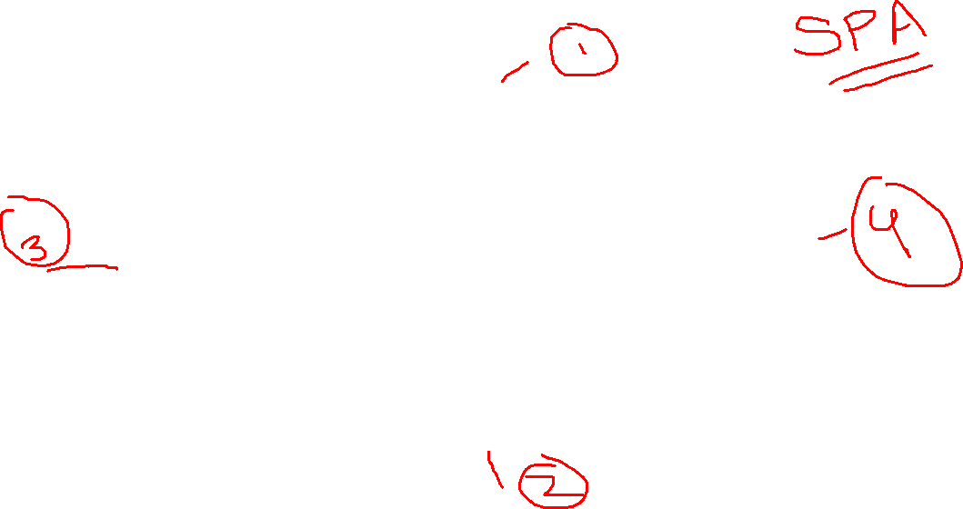
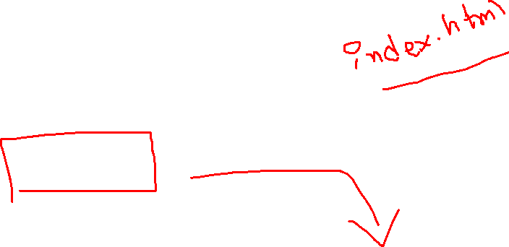
Why learn React ?
Component based Architecture.
HEADER
SIDENAV
MAIN CONTENT
FOOTER

Slide 12
Why learn React ?
Component are Reusable .

Slide 13
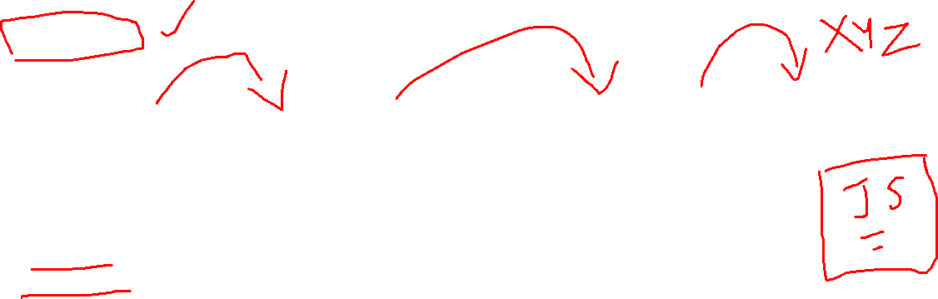
Why learn React ?
Component are Reusable .
React Angular Vue
Article
Component
Article
Component
Article
Component

Slide 14
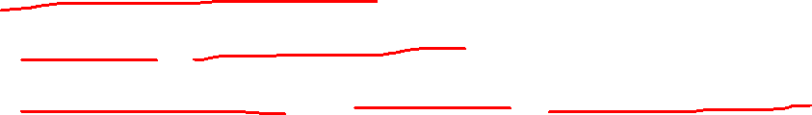
Why learn React ?
Component are Reusable .
Passing right data into the Article Component.
For Enterprise applications ,the ability to reuse of code will be a huge plus point.

Slide 15
Why learn React ?
React is Declarative.

Slide 16

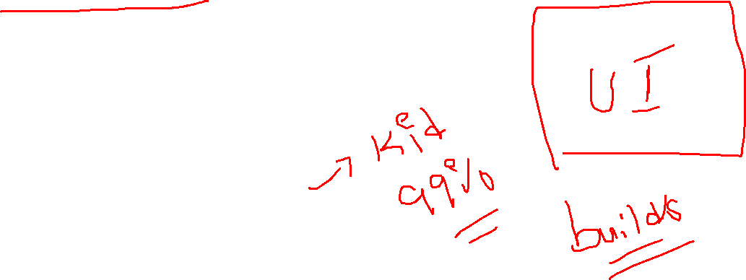
Why learn React ?
React is Declarative.
Tell React what you want and React will build the actual UI.
Ex: You are asking an artist to draw painting for you.

Slide 17

Why learn React ?
React will handle efficiently updating and rendering of the components.
DOM updates are handles gracefully in React.

Slide 18
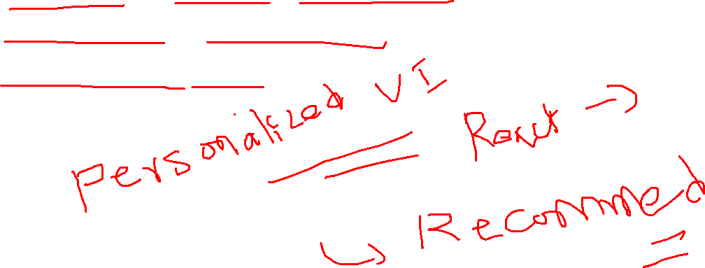
More on Why React ?
Seamlessly integrate react into any of your applications.
Portion of your page or a complete page or even the entire application itself.
React native for mobile applications.

Slide 19
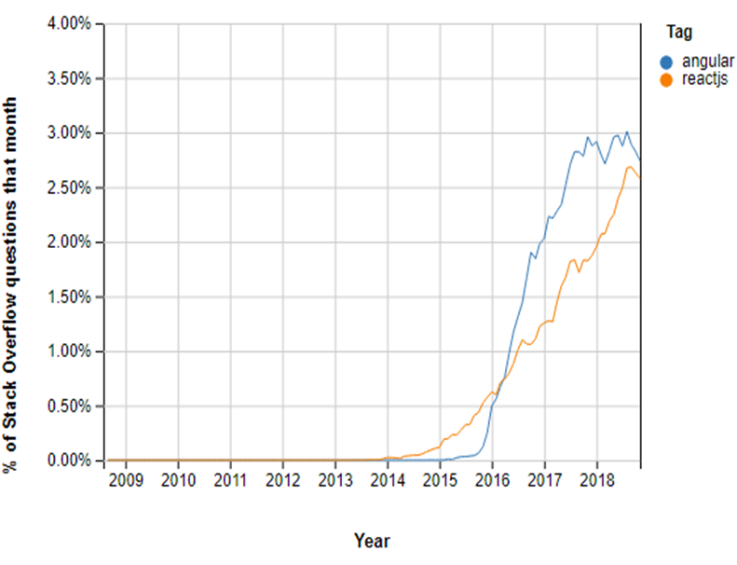
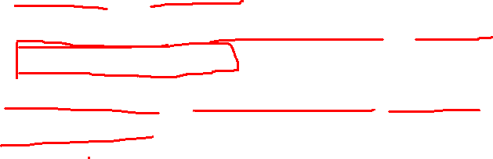
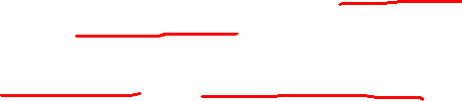
Angular vs React
When to Choose to React?
React native framework will be the ideal choice for your app in the below-given cases:
You need an app with multiple events.
When your application development team has expertise in HTML, CSS, and JavaScript.
You should use React when your requirement demands a personalized app solution.
You want to create shareable components in your app project.

Slide 20
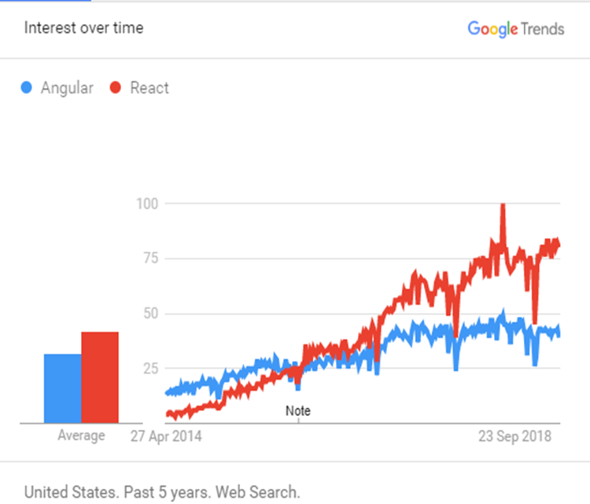
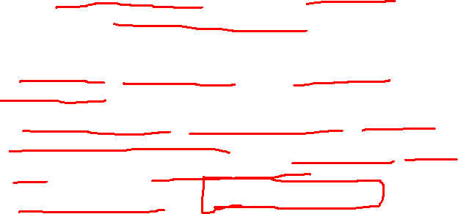
Angular vs React
When to Choose Angular?
Angular is a framework that will be the ideal choice for your app in the below-given cases:
You want ready-to-use solutions and want higher productivity.
When you want a large-scale feature-rich application
When the development team has experience with Java, C#, and previous versions of Angular
App complexity remains Low to Medium level.

Slide 21
React Components/Features

Slide 22
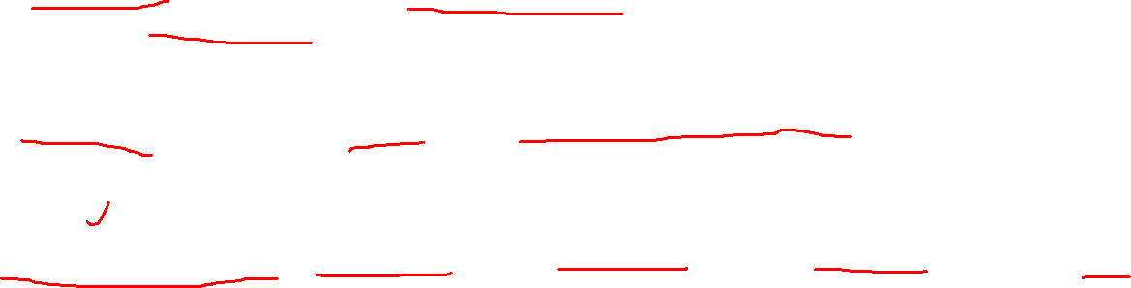
What are features ?
JSX : JSX is an extension to JavaScript.
Components: Components are like pure JavaScript functions that help make the code easy by splitting the logic into reusable independent code.
Virtual DOM: React creates a virtual dom, i.e., in-memory data -structure cache.
JavaScript Expressions: JS expressions can be used in the jsx files using curly brackets, for example {}.

Slide 23
What is and Why JSX ?

Slide 24
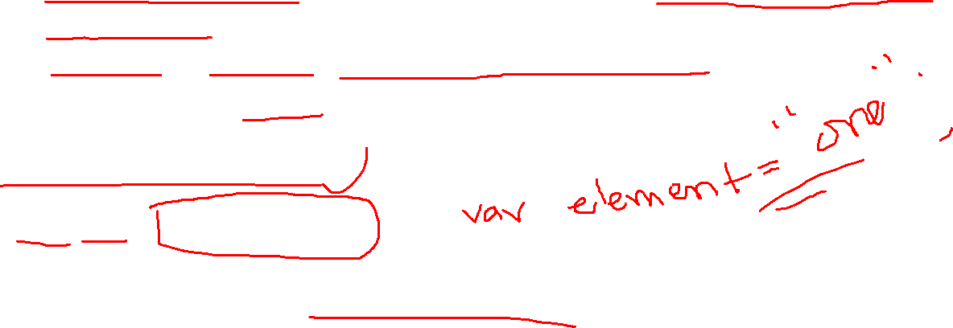
Introducing JSX
JSX stands for JavaScript XML. JSX allows us to write HTML in React. JSX makes it easier to write and add HTML in React.
It is recommend using it with React to describe what the UI should look like.
JSX produces React “elements”.
Consider this variable declaration:
const element = <h1>Hello, world!</h1>;
It is called JSX, and it is a syntax extension to JavaScript.

Slide 25
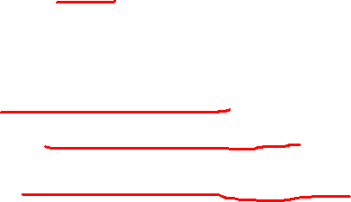
Why JSX?
React embraces the fact that rendering logic is inherently coupled with other UI logic:
How events are handled
How the state changes over time
How the data is prepared for display

Slide 26
What is a Component ?
What are the types of Components ?

Slide 27
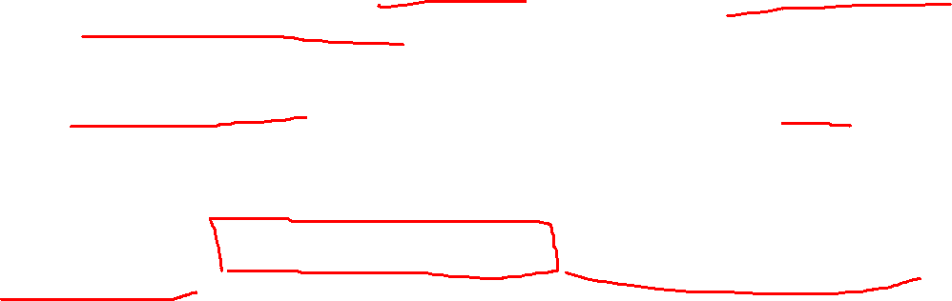
What is a component ?
A component is a small reusable chunk of code. Components are the core building block of React apps..
A React app can be seen as a component tree — having one root component (“App”) and then many nested child components.
These are like javascript functions. They accept arbitrary inputs (called “props”) and need to return/ render some JSX code (React elements) which describes what should appear on the screen.
We can also use multiple JSX in a component. Variables and conditions should be inside render method.

Slide 28
Types of components?
Class Components
Functional Components
Class components make use of ES6 class and extend the Component class in React.
A Functional component is a function that takes props and returns JSX.

Slide 29
How will Components Communicate each Other ?

Slide 30
How will components communicate?
We will cover the following topics for communication:
What is Props?
What is State?
State Vs Props

Slide 31
What are Props ?
Why Props ?
How to use Props ?

Slide 32
What are Props?
Props are the short name for properties and are immutable.
Any information that gets passed from one component to another is known as ‘props.
Props are passed to components via HTML attributes.
The component receives the argument as a props object.
To access that information, we have to use the JSX expression this.props.

Slide 33
What is a State ?
Why States ?
How to use States ?

Slide 34
What is State?
The behavior of the app/component at a given moment in time is defined by the state.
Component's data will be stored in the component’s state.
This state can be modified based on user action or other action.
When a component state is changed, React will re-render the component to the browser.

Slide 35
Props vs States

Slide 36
State Vs Props
Props are immutable i.e., once we set the props then it cannot be changed, while State is an observable object that is used to hold data that may change over time and used to control the behavior after every change.
While Props are set by the parent component, State is generally updated by event handlers.

Slide 37
React Routing

Slide 38
React Routing
React Router is a standard library for routing in React. It enables the navigation among views of various
components in a React Application.
We will use the react-router-dom package to configure routing in the React app.
Steps to Configure Routing in React App
Create React App
Install a React Router
Create React Class Components
Configure Routing in App Component
Demo
Link for React Routing Demo

Slide 39
Resources
https://reactjs.org/docs/getting-started.html

Slide 40
Test Your Understanding

Slide 41
ReactJS covers _________
User Interface layer in an application
Data layer in an application
Both
None of above

Slide 42
React.JS focuses on which of the following part when considering MVC?
V
M
C
None of these.

Slide 43
ReactJS uses _____ to increase performance
Original DOM
Virtual DOM
Both
None of these.

Slide 44
What function can be used to change the state of a React component ?
this.changeState
this.setState
this.State = {}
None of these.

Slide 45
Which is a root component in React ?
Content
Header
App
None of these.

Slide 46
React Js is developed by _____________
Google
Microsoft
Facebook
None of these.

Slide 47

Any Questions ?

